Slide 1

Ovarian Cancer Detection with Multi-Biomarker Predictive Modelling
Andrea Hannah
December 4, 2023

Slide 2
Introduction to Subject
Ovarian Cancer

Slide 3

Research Introduction
Goal: The goal of this project is to identify biomarkers and other factors that effectively predict Ovarian Cancer to improve early diagnosis screening.
Ovarian Cancer is a group of diseases that originate in the ovaries, in the fallopian tubes, or peritoneum. Ovaries produce estrogen and progesterone hormones in females, as well as reproductive eggs.
Ovarian Cancer is best treated at its earliest stages before becoming aggressive, as it is the fifth deadliest cancer to women and the deadliest cancer of the female reproductive system..
Therefore, early screening and diagnosis is key in successfully treating the disease, curing, or entering remission.
Presently, Ovarian Cancer is screened through two primary methods:
TVUS (transvaginal ultrasound) is a test using sound waves to look at the uterus, fallopian tubes, and ovaries. It can find a mass, but it can't tell if that mass is malignant (cancerous) or benign (non-cancerous). When it is used for screening, most of the masses found are not cancerous.
The CA-125 blood test measures the amount of a protein called CA-125 in the blood. Many women with ovarian cancer have high levels of CA-125. This test can be useful as a tumor marker to determine if treatment is working in women known to have Ovarian Cancer, because a high CA-125 level, which is above 35 U/ml, often decreases if treatment is working. The normal CA-125 range is 0-35 U/ml. The CA-125 blood test is less invasive.

Slide 4
Research Importance
The CA-125 blood test measures the amount of the protein, Cancer Antigen – 125 in the blood. Many women with ovarian cancer do, in fact, have high levels of CA-125. This test can be useful as a tumor marker to help guide treatment in women known to have Ovarian Cancer, because a high level will often decrease if cancer treatment is working.
Note, checking CA-125 levels has not been found to be as useful as a screening test for Ovarian Cancer because high levels of CA-125 is more often caused by common conditions such as endometriosis and pelvic inflammatory disease, and not everyone who has Ovarian Cancer has a high CA-125 level.
Therefore, other biomarkers may perform better than CA-125 when screening for Ovarian Cancer.

Slide 5
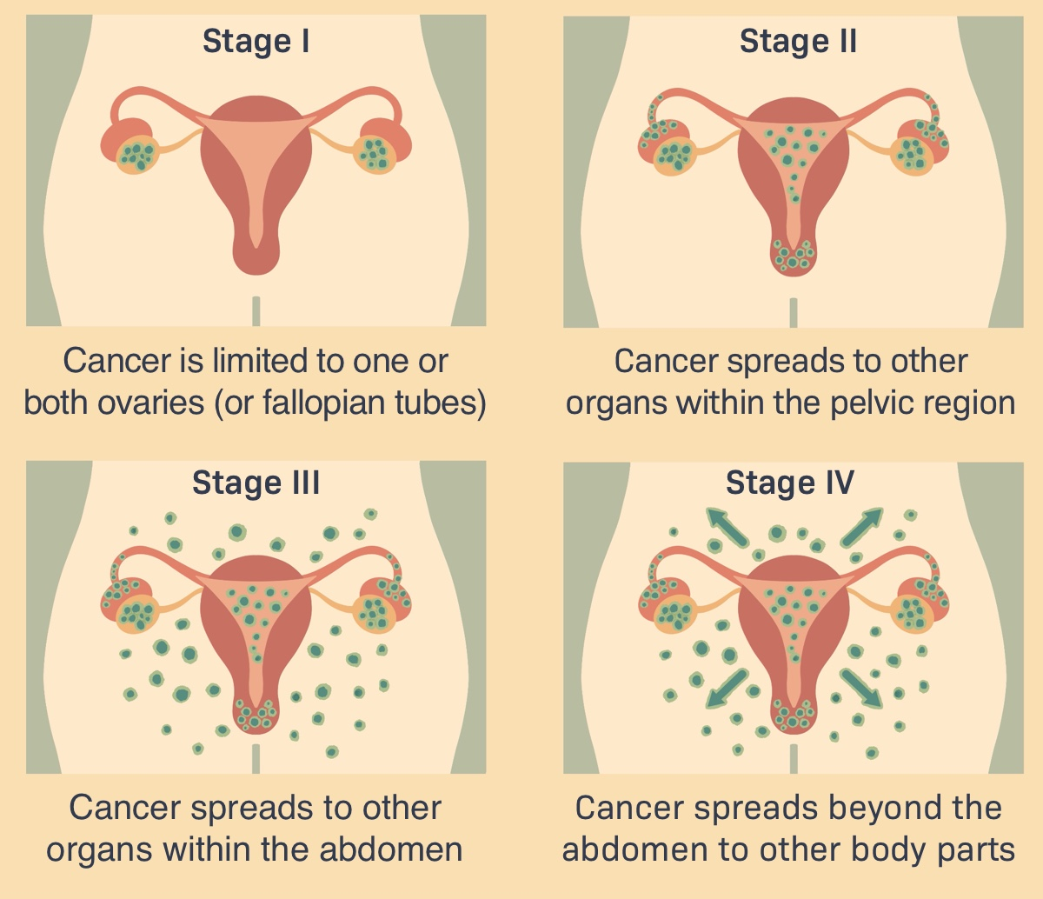
Objectives
Determine the best predictive biomarkers in a dataset for women then use machine learning to help predict Ovarian Cancer risk.
Help increase early detection to improve survivor outcomes for marginalized populations.
Image Source: https://advancedovariancancer.net/diagnosis/stages

Slide 6

Hypothesis
Multi-biomarker prediction is more effective than using CA-125 alone to predict Ovarian Cancer in women.

Slide 7
Review of Related Literature

Slide 8
Previous Research Findings
Lu Study: Decision Tree Machine Learning Model
Taleb Study: SVM vs. KNN Machine Learning Models
Study was based on 349 Chinese patients to predict Ovarian Cancer (OC) or Benign Ovarian Tumors (BOT).
Minimum Redundancy – Maximum Relevance (mRMR) feature selection method was applied on the 235 patients’ data (89 BOT and 146 OC) to select the most relevant features.
Eight notable features were selected by mRMR, with two identified as the top features by the decision tree model: human epididymis protein 4 (HE4) and carcinoembryonic+ antigen (CEA), which is a valuable marker for Ovarian Cancer prediction in patients with low HE4.
Decision Tree model was constructed and tested on the rest of the 114 patients (89 BOT and 25 OC). The results were compared with the predictions produced by using the Risk of Ovarian Malignancy Algorithm (ROMA) and logistic regression model.
Machine Learning has demonstrated that it is capable of better identifying ovarian cancer and its stages.
However, most modern research studies on Ovarian Cancer use a single classification model, leading to poor performance in diagnosis.
More sophisticated Machine Learning algorithms, Support vector machine (SVM) and K-Nearest Neighbor (KNN), are employed in this study.
SVM outperformed KNN in both training and validation performance and achieved an accuracy of 98.1% & 97.16% for training and validation, respectively.
If used in medical diagnosis systems, the proposed model can significantly improve the accuracy of Ovarian Cancer detection leading to effective treatment and an increase in patient survival rates.

Slide 9
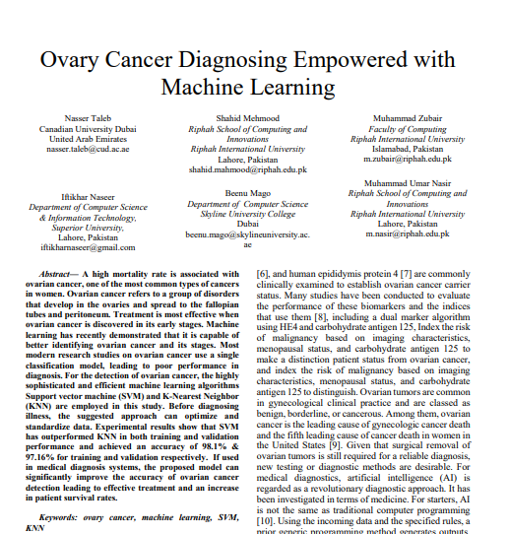
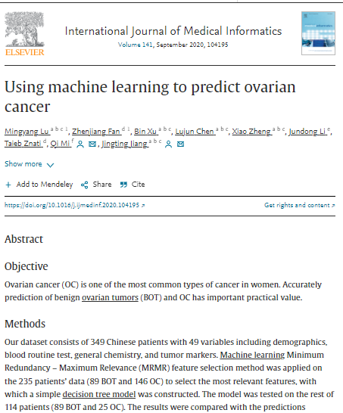
View of the Literature

Slide 10
Project Pipeline

Slide 11
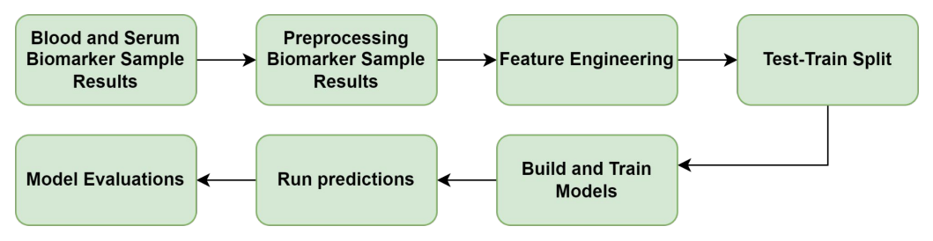
Project Pipeline

Slide 12
Data Gathering

Slide 13
Data Gathering
The original Ovarian Cancer Dataset has 349 observations and 49 variables.
The Cleaned Dataset was sourced from Kaggle, but this data was originally used in other research and consist of clinical data from 349 Chinese patients at the Third Affiliated Hospital of Soochow University. See the Lu et al. study.
The cleaned data set is comprised of 235 patients’ data collected between July 2011 and July 2017 and 49 variables including Age, Menopause (Y/N), HE4 and CA125, among other biomarkers found in blood or serum samples.
This dataset includes the following initial biomarker features of interest:
Age | CA-125 | HE4| ALP | Ca | Menopause | MCH | MCV
Exploratory Data Analysis was performed to study the relationships between biomarkers before proceeding to setting up the algorithms and performing machine learning.
mRMR was deployed for additional feature selection and SVM, KNN, and Decision Tree models were deployed for prediction with KNN performing the best with the highest accuracy.

Slide 14
View of Variables
Index | Biomarker | Description
1 | AFP | Alpha-fetoprotein
2 | AG | Anion Gap
3 | Age | Age
4 | ALB | Albumin
5 | ALP | Alkaline phosphatase
6 | ALT | Alanine aminotransferase
7 | AST | Aspartate aminotransferase
8 | BASO# | Basophil Cell Count
9 | BASO% | Basophil Cell Ratio
10 | BUN | Blood Urea Nitrogen
11 | Ca | Calcium
12 | CA125 | Cancer Antigen 125
13 | CA19-9 | Cancer Antigen 19-9
14 | CEA | Carcinoembryonic Antigen
15 | CL | Chlorine
16 | CO2CP | Cabon Dioxide-Combining Power
17 | CREA | Creatinine
18 | DBIL | Direct Bilirubin
19 | EO# | Eosinophil Count
20 | EO% | Eosinophil Ratio
21 | GGT | Gama Glutamyltransferasey
22 | GLO | Globulin
23 | GLU. | Glucose
24 | HCT | Hematocrit
25 | HE4 | Human Epididymis Protein 4
Index | Biomarker | Description
26 | HGB | Hemoglobin
27 | IBIL | Indirect Bilirubin
28 | K | Potassium
29 | LYM# | Lymphocyte Count
30 | LYM% | Lymphocyte Ratio
31 | MCH | Mean Corpuscular Hemoglobin
32 | MCV | Mean Corpuscular Volume
33 | Menopause | State of Menopause
34 | Mg | Magnesium
35 | MONO# | Mononuclear Cell Count
36 | MONO% | Monocyte Ratio
37 | MPV | Mean Platelet Volume
38 | Na | Sodium
39 | NEU | Nuetrophil Ratio
40 | PCT | Thrombocytocrit
41 | PDW | Platelet Distribution Width
42 | PHOS | Phosphorus
43 | PLT | Platelet Count
44 | RBC | Red Blood Cell Count
45 | RDW | Red Blood Cell Distribution Width
46 | TBIL | Total Bilirubin
47 | TP | Total Protein
48 | TYPE | Benign or Malignant
49 | UA | Uric Acid

Slide 15
Preliminary Data Analysis

Slide 16
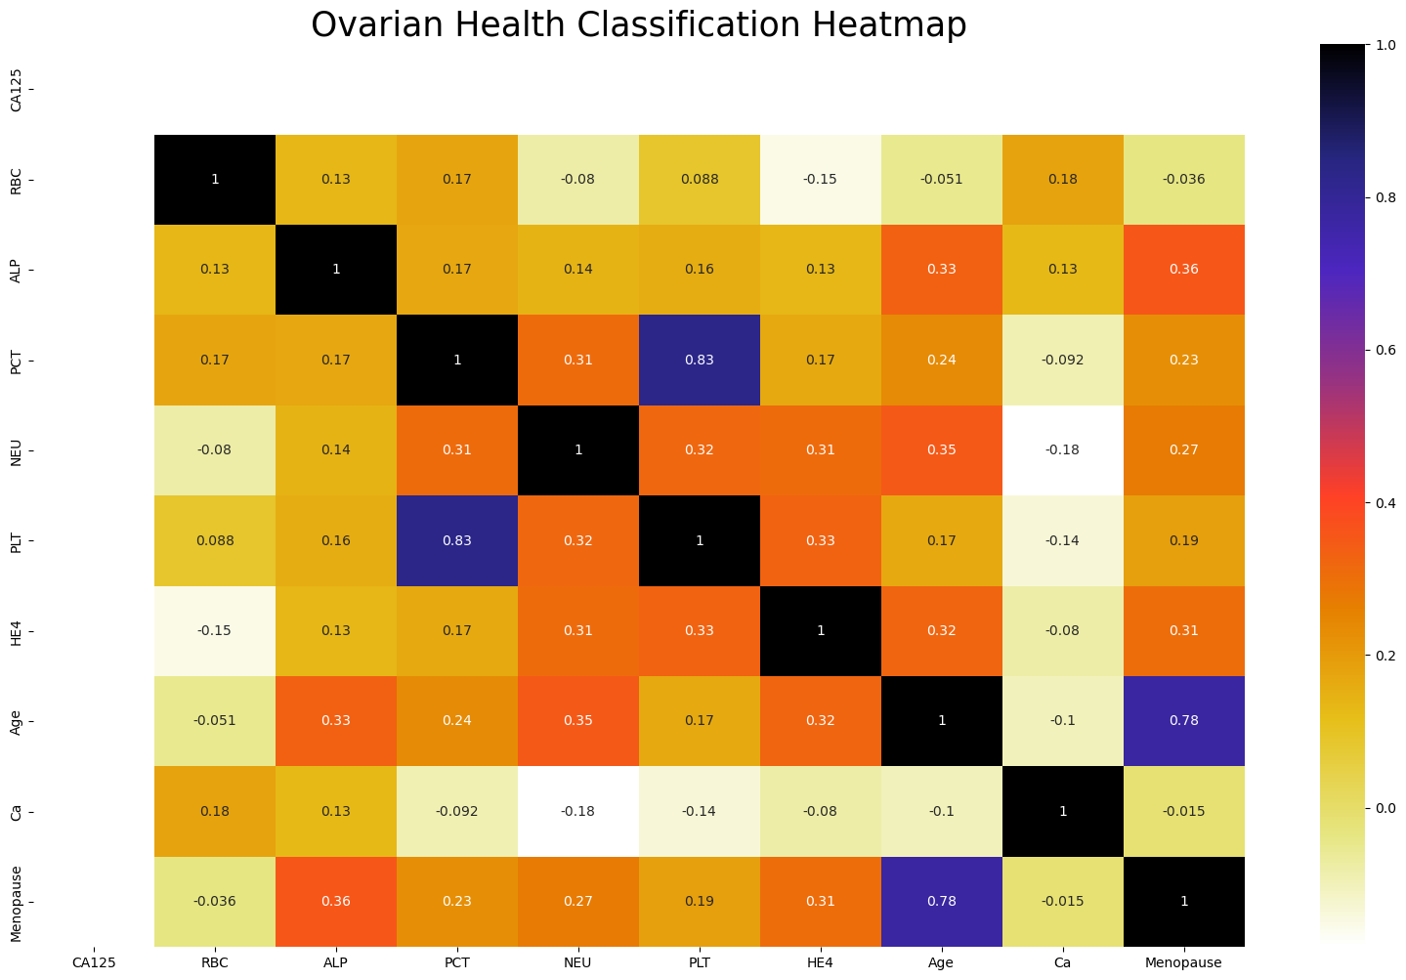
Heatmap

Slide 17
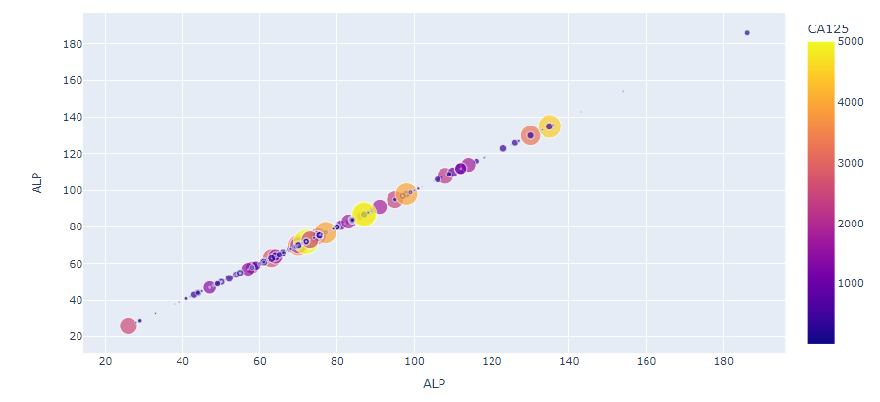
Scatterplot 1 Example
Examining relationship between ALP and CA125 levels.
Higher Alkaline Phosphatase (ALP) levels are associated with higher CA125 levels of risk.

Slide 18
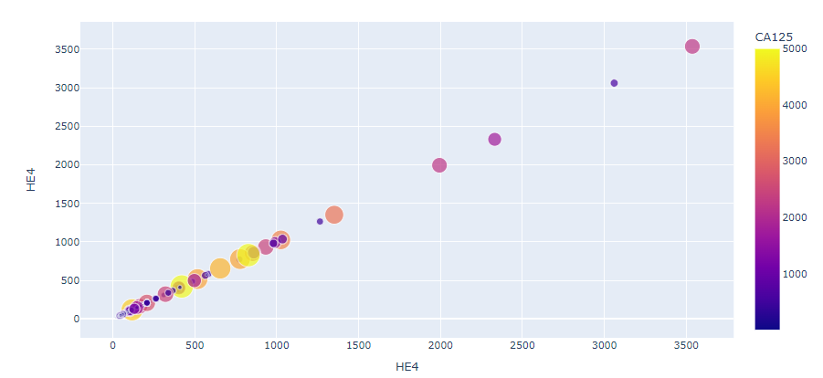
Scatterplot 2 Example
Examining relationship between HE4 and CA125 levels.
Higher Human Epididymis 4 (HE4) protein levels are not supported as related with higher CA125 levels of risk with this dataset. Instead, lower HE4 levels are associated with higher CA125 levels.

Slide 19
Scatterplot Results Summary
Using the Scatterplot visualization method, we see the relationship between variables. The preliminary visualization results indicated the following about the dataset:
Higher Calcium levels are associated with higher CA125 levels of risk.
Higher ALP levels are associated with higher CA125 levels of risk.
Higher HE4 levels are not supported as related with higher CA125 levels of risk with this dataset. Instead, lower HE4 levels are.
As expected, menopause and age correlate with higher CA125 levels.
But will these associations be present in our mRMR feature selections for our target variable, Ovarian Cancer malignancy?

Slide 20
Preprocessing and Feature Selection

Slide 21
Preprocessing and Feature Selection
The data was already clean, but as part of preprocessing, risk levels were applied to 'CA-125', where measures above 35 U/ml (units per milliliter) were considered higher risk as unhealthy or indicative of cancer or some other condition and levels below that measure, were considered healthy or lower risk.
mRMR was used to narrow down the 50 biomarker features to the top 10 selections:
'Age', 'CREA', 'LYM%', 'AST', 'CA125', 'PDW', 'Menopause', 'NEU', 'CEA', and 'LYM#'.
From this, we see that 'ALP', 'HE4', and 'Ca' are not in the top features defining the X-variable for the first set of predictive models.
In the second set of chosen features, some of which are supported by the literature, defining X for the predictive models, we include: 'CA125', 'RBC', 'ALP', 'PCT', 'NEU', 'PLT', 'HE4', 'Age', 'Ca', 'Menopause’.
CA125 alone serves as the third chosen feature selected, defining X for the predictive models.

Slide 22
Machine Learning Models

Slide 23
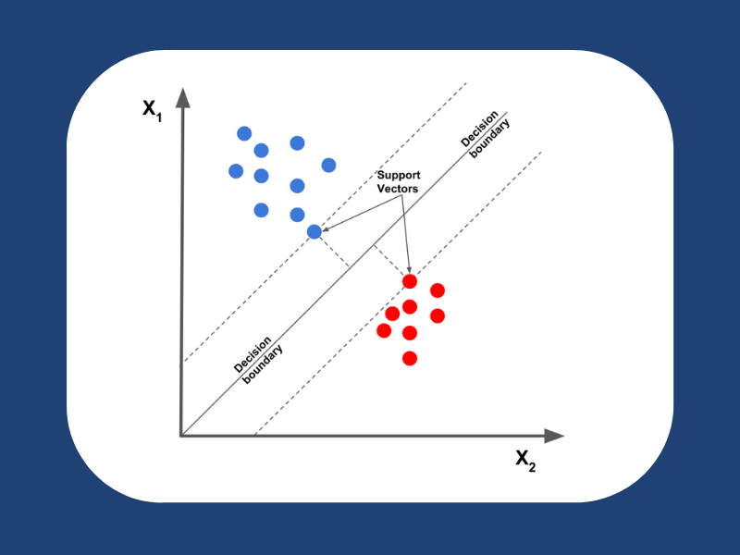
SVM – Support Vector Machine
SVM or Support Vector Machine is a linear classification and regression algorithm that creates a line or a hyperplane between data of two classes.
The SVM takes the labeled Ovarian Cancer dataset as an input and the output produces a line that separates where the points are closest to the line from both classes when possible.
Then the distance between the line and support vectors are computed as margin, which are maximized for the optimal hyperplane. This creates a decision boundary, where the separation of the two classes is at its widest.
Image source: https://analyticsarora.com/8-unique-machine-learning-interview-questions-on-svm/

Slide 24
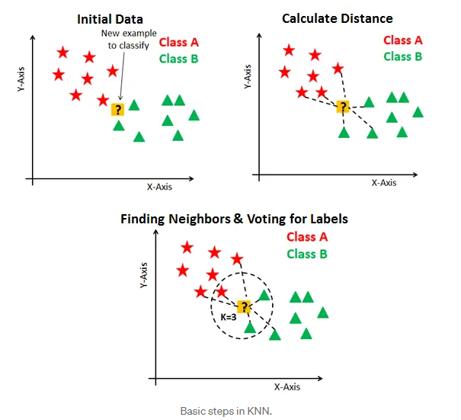
KNN – K Nearest Neighbors
KNN or K Nearest Neighbor is a simpler machine learning algorithm than SVM but still more sophisticated than decision trees.
KNN classifies data points based on its similarity with how its neighbor or earlier stored data points are classified.
KNN works well for labeled, small datasets. The K represents the number of nearest neighbors used to classify new data points.
Adjusting the value of K is a function of parameter tuning; using the square root of the target testing data, K could be identified as 9.
Image source: https://towardsdatascience.com/knn-visualization-in-just-13-lines-of-code-32820d72c6b6

Slide 25
Decision Trees
Decision trees use a tree-like flowchart model of decisions and the corresponding possible consequences. A decision tree consists of three types of nodes:
Root Node - represents the feature all other nodes split from
Decision Nodes - represent a test on a feature or attribute for a decision to be made on. As the tree depth increases, the loss entropy should decrease, and the information gain should increase until we end up with a pure leaf or end node
Leaf/End Nodes - represents the outcome with reduced uncertainty
It is advantageous to use decision trees because they are easily interpretable and understandable after a brief explanation. However, a disadvantage is that model calculation can become complex if many values are uncertain. Since our data has no missing values, there is little to no uncertainty to impact decision trees as a selected model. Accuracy of the decision tree model is increased when the depth increases.

Slide 26
Machine Learning Model Comparisons
Support Vector Machine
Lower computation power needed
High accuracy
Works for classification and regression problems, but very popular with classification
K Nearest Neighbor
Ease of interpretation
Low calculation time
Works for classification and regression problems, and can have very effective predictive power
Decision Trees Classifier
A single decision tree has faster computation
Uses rules to predict from input that is a dataset with features
May experience overfitting if maximum depth is reached.
Note, the test-split is based on a 70/30 ratio for the dataset, and the evaluation of model performance will primarily focus on the Accuracy metric.

Slide 27
Machine Learning Method Results

Slide 28
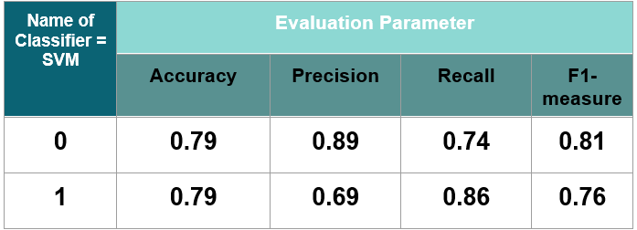
SVM mRMR w/CA-125 Biomarkers: 'Age', 'CREA', 'LYM%', 'AST', 'CA125', 'PDW', 'Menopause', 'NEU', 'CEA', and 'LYM#’

Slide 29
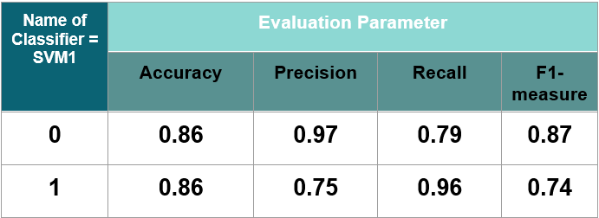
SVM Lit Biomarkers: 'CA125', 'RBC', 'ALP', 'PCT', 'NEU', 'PLT', 'HE4', 'Age', 'Ca', 'Menopause’

Slide 30
SVM mRMR w/o CA-125 Biomarkers: 'Age', 'CREA', 'LYM%', 'AST', 'Menopause', 'PDW', 'NEU', 'HE4', 'LYM#', 'PCT’
Name of Classifier = SVM-mRMR, no ca125 | Evaluation Parameter
 | Accuracy | Precision | Recall | F1-measure
0 | 0.87 | 0.90 | 0.88 | 0.89
1 | 0.87 | 0.83 | 0.86 | 0.84

Slide 31
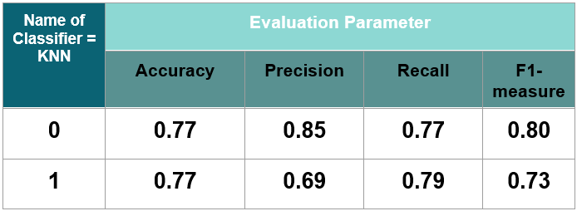
KNN 1 mRMR w/CA-125 Biomarkers: 'Age', 'CREA', 'LYM%', 'AST', 'CA125', 'PDW', 'Menopause', 'NEU', 'CEA', and 'LYM#'

Slide 32
KNN 2 Lit Biomarkers: 'CA125', 'RBC', 'ALP', 'PCT', 'NEU', 'PLT', 'HE4', 'Age', 'Ca', 'Menopause'
Name of Classifier = KNN | Evaluation Parameter
 | Accuracy | Precision | Recall | F1-measure
0 | 0.77 | 0.81 | 0.81 | 0.81
1 | 0.77 | 0.71 | 0.71 | 0.71

Slide 33
KNN 3 mRMR w/o CA-125 Biomarkers: 'Age', 'CREA', 'LYM%', 'AST', 'Menopause', 'PDW', 'NEU', 'HE4', 'LYM#', 'PCT'
Name of Classifier = KNN | Evaluation Parameter
 | Accuracy | Precision | Recall | F1-measure
0 | 0.90 | 1.00 | 0.84 | 0.91
1 | 0.90 | 0.80 | 1.00 | 0.89

Slide 34
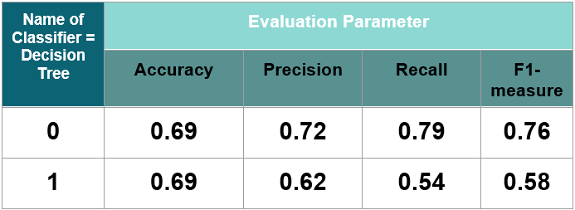
Decision Tree 1 mRMR w/CA-125 Biomarkers: 'Age', 'CREA', 'LYM%', 'AST', 'CA125', 'PDW', 'Menopause', 'NEU', 'CEA', and 'LYM#'

Slide 35
Decision Tree 2 Lit Biomarkers: 'CA125', 'RBC', 'ALP', 'PCT', 'NEU', 'PLT', 'HE4', 'Age', 'Ca', 'Menopause'
Name of Classifier = Decision Tree, | Evaluation Parameter
 | Accuracy | Precision | Recall | F1-measure
0 | 0.75 | 0.78 | 0.81 | 0.78
1 | 0.75 | 0.69 | 0.64 | 0.65

Slide 36
Decision Tree 3 mRMR w/o CA-125 Biomarkers: 'Age', 'CREA', 'LYM%', 'AST', 'Menopause', 'PDW', 'NEU', 'HE4', 'LYM#', 'PCT'
Name of Classifier = Decision Tree | Evaluation Parameter
 | Accuracy | Precision | Recall | F1-measure
0 | 0.73 | 0.77 | 0.79 | 0.78
1 | 0.73 | 0.67 | 0.64 | 0.65

Slide 37
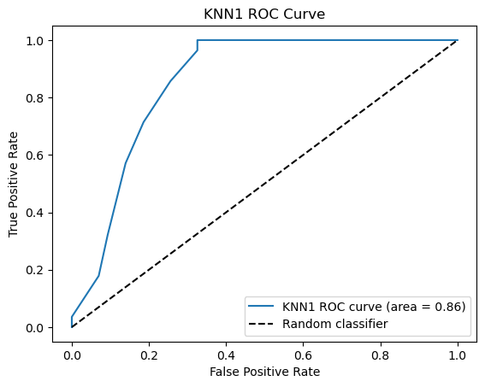
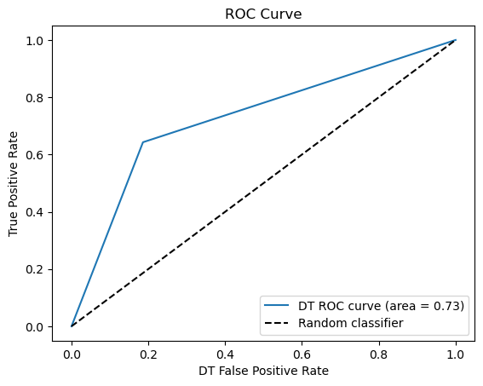
KNN and SVM AUC-ROC comparison

Slide 38
Summary view of results
Model | Accuracy | Precision | Recall | F-1 score | Rank
SVM 1 | 79% | 69% | 86% | 76% | 4
SVM 2 | 86% | 75% | 96% | 74% | 3
SVM 3 | 87% | 83% | 86% | 84% | 2
KNN 1 | 77% | 69% | 79% | 73% | 5
KNN 2 | 77% | 71% | 71% | 71% | 6
KNN 3 | 90% | 80% | 100% | 89% | 1
DT 1 | 69% | 62% | 54% | 58% | 9
DT 2 | 75% | 69% | 64% | 67% | 7
DT 3 | 73% | 67% | 64% | 65% | 8
Model Key by Features Extraction Method
1: mRMR selected features - 'Age', 'CREA', 'LYM%', 'AST', 'CA125', 'PDW', 'Menopause', 'NEU', 'CEA', and 'LYM#’
2: Literature supported features – 'CA125', 'RBC', 'ALP', 'PCT', 'NEU', 'PLT', 'HE4', 'Age', 'Ca', 'Menopause
3: mRMR selected features excluding 'CA125' - 'Age', 'CREA', 'LYM%', 'AST', 'Menopause', 'PDW', 'NEU', 'HE4', 'LYM#', 'PCT’

Slide 39
Conclusions & Future Study

Slide 40
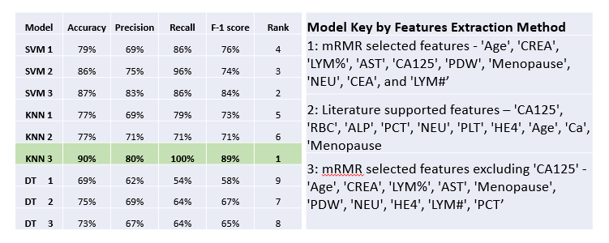
Conclusions
This work produced 10 features beneficial in predicting Ovarian Cancer using mRMR, and those include: 'Age', 'CREA', 'LYM%', 'AST', 'CA125', 'PDW', 'Menopause', 'NEU', 'CEA', and 'LYM#’.
The best performing models with these selected biomarker features from the original biomarker selection is SVM at 79% overall accuracy and the worst performing was Decision Trees at 69% overall accuracy.
For the second set of biomarkers, SVM was the best performing predictive model using features: 'CA125', 'RBC', 'ALP', 'PCT', 'NEU', 'PLT', 'HE4', 'Age', 'Ca', 'Menopause’. SVM and Decision Trees model using these features performed better at 86% and 75% overall accuracy, than the MRMR selected features for their counterpart models.
Accuracy for mRMR selected features excluding CA-125 (['Age', 'CREA', 'LYM%', 'AST', 'Menopause', 'PDW', 'NEU', 'HE4', 'LYM#', 'PCT’]) which ends up also excluding CEA and replaces the two variables with HE4 and PCT, shows SVM performance is 87%, KNN is 90%, and Decision Trees is 73%. KNN is the better performing model for variables selected by mRMR with targeted exclusion of CA-125.
Model Accuracy for CA-125 alone shows performance for SVM is 73%, KNN is 65%, and Decision Trees is 69%. SVM is the better performing model when the only variable is CA-125. SVM, KNN, and DT for this singular variable practiced in clinics are outperformed by their counterparts for mRMR selected features excluding CA-125 for accuracy.
Decision Trees only performed better with CA-125 included in the variable/feature selection from previous model runs but given that SVM and then KNN appear to be the more superior performing models throughout the entirety of the runs for the most part, the mRMR selected features SVM and KNN models that exclude CA-125 support the use of a multi-biomarker approach to perform early diagnosis of Ovarian Cancer rather than relying only on CA-125.
A larger dataset is required to focus on postmenopausal women as a subset of the data, and this could yield varied results in the mRMR feature selection process.

Slide 41
Missing Variables for Future Study
Racial identification
Number of pregnancies
Number of c-sections
Status of other gynecologic or reproductive system conditions
Weight (BMI, obesity)
Inherited factors
Diet and Nutrition (calcium intake, vitamin D)
Lifestyle (sun exposure, exercise)
Stress factors
These missing social and environmental factors and others are features which could improve research and help with eliminating disparities in clinical practice for those with known factors that contribute to poor health outcomes. Additional datasets with these attributes can be analyzed for future study.

Slide 42
Future Study
Rather than solely relying on CA-125-only test for early diagnosis and screening, implementing the use of a multi-biomarker screener in clinical environments could help eliminate disparities in screening/diagnosis, treatment, and survival rates for Ovarian Cancer patients of targeted populations.
A future study would be to supplement additional work to be done on screening biomarkers for patients based on racial and environmental characteristics but to eventually analyze and predict comorbidities in order to predict the composition of the wholistic care team of specialists (heart-renal-metabolic, etc.) needed that may be required for particular cancer patients to improve survival rates by starting with a larger dataset requested from the National Cancer Institute or create one in-house by adding a data sharing clause in patient forms.
An in-house study at a historical African American and Black-serving institution, like Meharry makes sense, given that 5-year relative survival rate for Ovarian Cancer increased from 33% to 48% among non-Hispanic women of European ancestry but decreased from 44% to 41% in African American women. The need is there.
The study might best be served as a joint collaboration between Meharry Institutes: the Center for Advanced Scientific Computing, Innovation and Center of Women’s Health, and eventually the Center of Health Policy, since there are disparities in ovarian screening and treatment costs under Medicaid. Alternatively, a study could be established at another institution sharing a mandate for improved equity in African American health.

Slide 43
Literature References
Lu, M., Fan, Z., Xu, B., Chen, L., Zheng, X., Li, J., ... & Jiang, J. (2020). Using machine learning to predict ovarian cancer. International Journal of Medical Informatics, 141, 104195. https://www.sciencedirect.com/science/article/abs/pii/S1386505620302781
Taleb, N., Mehmood, S., Zubair, M., Naseer, I., Mago, B., & Nasir, M. U. (2022, February). Ovary cancer diagnosing empowered with machine learning. In 2022 International Conference on Business Analytics for Technology and Security (ICBATS) (pp. 1-6). IEEE. https://ieeexplore.ieee.org/abstract/document/9759010/

Slide 44
Acknowledgements

Slide 45
Acknowledgements I dedicate this work to my mother. I am grateful for your lifetime of enduring love and support. My mother, grandmother, and daughter are my greatest inspirations, and it is to them that I dedicate my program completion in Biomedical Data Science at Meharry. I also thank my extended family, the professors at MMC-SACS, and everyone who supported me along the way.

Slide 46
Thank you for listening. Are there any Questions?

